Slide 1

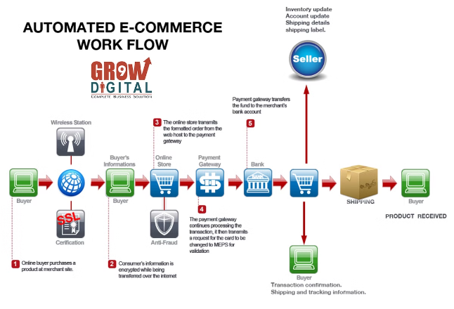
Introduction to Ecommerce Microservices Architecture
Ecommerce Microservices Architecture enables building complex applications by breaking them into smaller, independent services. Each service focuses on a specific business functionality, allowing for faster development and deployment.
AC
by Ankit Chauhan

Slide 2

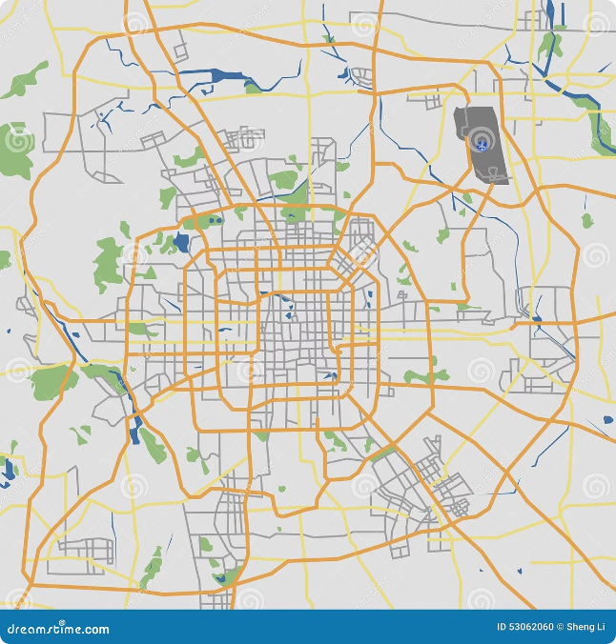
Ecommerce Service Registry
The Service Registry acts as a central directory for all microservices. It stores metadata about each service, such as its location, API endpoints, and version. This helps other services easily discover and connect with each other.
Service Discovery
Service Versioning
Services can easily find and communicate with each other.
Manage different versions of services.
Service Health Monitoring
Track the health and status of each service.

Slide 3


Ecommerce API Gateway
The API Gateway acts as a single entry point for all external requests to the microservices. It handles routing, security, and rate limiting, providing a consistent interface to external clients.
1
Request Routing
2
Authentication & Authorization
Directs requests to the appropriate service.
Secures access to services.
3
Rate Limiting
4
Caching
Prevents overload by limiting the number of requests per unit of time.
Improves performance by caching frequently accessed data.

Slide 4
Ecommerce Config Server
The Config Server centralizes all configuration data for the microservices. This ensures consistency and allows for easy updates and rollbacks without needing to redeploy services.
Centralized Configuration
Dynamic Configuration
All configuration data is stored in one location.
Configuration can be updated without restarting services.
Easy updates and rollbacks.
Supports different environments.

Slide 5


Customer Service
The Customer Service handles all operations related to customers, including registration, profile management, and order history. It ensures a seamless customer experience by providing access to personalized information.
Customer Registration
1
Allows customers to create accounts and provide personal details.
2
Profile Management
Customers can update their profile information, including shipping addresses and payment methods.
Order History
3
Provides customers with access to their past orders and purchase history.
4
Customer Support
Offers customer support channels for resolving issues and inquiries.
orientation=vertical twosided=false

Slide 6



Authentication Service
The Authentication Service is responsible for verifying user identities and granting access to protected resources. It uses secure authentication mechanisms to ensure the safety of user data.
Password Authentication
Allows users to log in using their username and password.

Slide 7

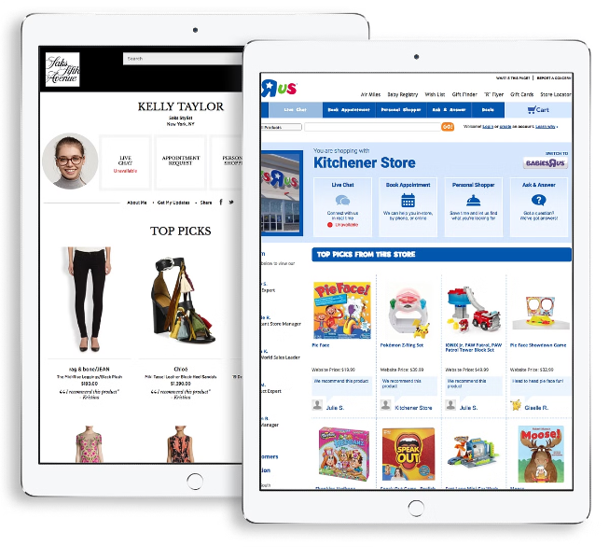
Product Service
The Product Service manages all product-related data, including product descriptions, images, pricing, and availability. It provides a comprehensive view of the products offered by the ecommerce platform.
Product Catalog
Stores all product information, including details, images, and prices.
Inventory Management
Tracks product availability and updates inventory levels in real time.
Product Search
Enables customers to search for products based on keywords or filters.
Product Recommendations
Suggests relevant products based on customer browsing history or preferences.

Slide 8

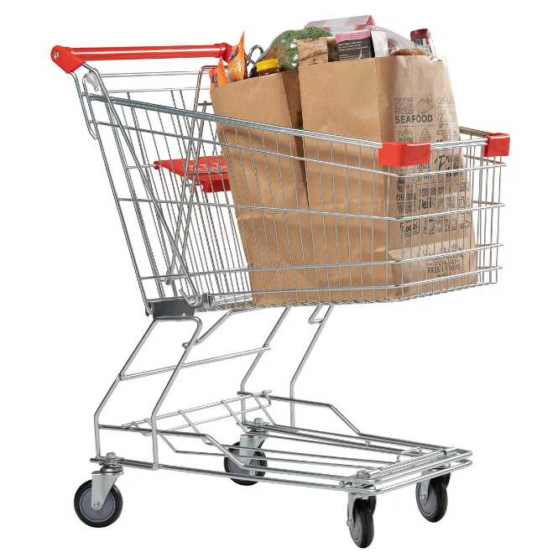




Cart and Order Services
The Cart and Order Services handle all aspects of the shopping cart and order management process, from adding items to the cart to processing payments and shipping orders.
Add to Cart
Allows customers to add items to their shopping cart.
Checkout
Processes the order, including payment and shipping details.
Order Fulfillment
Handles order processing, packaging, and shipping.
Order Tracking
Provides customers with real-time updates on their order status.
orientation=horizontal

